Slide 1
The English language course welcomes you all Teacher: BENAFIA Ahlam
ahlambenafia@gmail.com

Slide 2
Students will be able to develop the following skills:
Reading
Writing
Read and understand scientific articals
Write and produce accurate scientific articals
Listening
Speaking
Listen to related scientific terms and understand them
Present their scientific research proposal(public speaking)

Slide 3
welcome!

Slide 4
Unit01: scientificresearch

Slide 5
1-What is a research:
The word research is composed of two syllables: the prefix RE that means doing something again, or over and over. The verb to SEARCH that means to investigate, examine, test and try closely and carefully. Togather they form a noun that describes a careful, systematic, and patient investigation in a certain field of study.

Slide 6
2-characteristics of research:
1- Logical: a good research is the one that comes with a prosseceable reasoning.
2-Systematic: structured with a well set of rules, steps and stages.
3-Replicable: able to be veryfied in other contexts.
4-Empirical: related to real situations.
5-Purposive: conducted for a reason(aim).

Slide 7
3-Identifying a research problem(topic):
From ourselves
From others
(supervisor)
Previous research
Avoid problems that are:
Too general
Too specialized
Not worth arguing

Slide 8
Unit2: a research question

Slide 9
1-how to form a question:
1.There are two2 types of quest. :
a. YES/ NO quest: always start with a verb/ aux. Eg: Is python better than Java?
Are open source communities safe?
Did you find any bugs?
b-WH/H quest: always start with words like what, why, where, how, how often, when
Eg: What is your favourite programming language?
How long does it take you to solve errors?

Slide 11
3.Variables in a research
1. Independent variable: the variable that has the power to effect and make a change in the other variable. That is called the dependent variable. Known as the cause.
2. Dependent variable: the variable that is effected by any changes that might happen on the Independent variable, known as the effect.
3. Control variables: they are the parts of the research/study that do not change or get effected by any element. They are a fixed point in the research.

Slide 14
Unit3: a research approach

Slide 15
The thesis/dissertation.
1.Theoratical part
2.practical part
-Preliminary pages
-Introduction
-Literature review
-conclusion
-Method/Approach
-Materials/ Tools
-Results and Discussion
Lesson:

Slide 16
1- Methods/ Approaches
a.Quantitative
b.Qaulitative
A type of educational research in which the researcher decides what to study.
A type of educational research in which the researcher relies on the views of the participants.
Lesson:

Slide 17
Quantitative data
vs
Qualitative data
Quantitative research looks at patterns in numeric data. Quantitative research gathers data in numerical form which can be put into categories or measured in units of measurement.
Gathers information that are not in numerical form. the data is typically descriptive data. When you think of qualitative data, Think of the word 'quality' – because in qualitative This type of data can be a used graphs,look at a phenomenon and tables.

Slide 19
Quantitative data
Examples
vs
Qualitative data
-Application forms
-Closed ended Questionnaires
-IQ Tests
-Measurements
-Diary accounts
-Document review
-Open ended Questionnaires
-Unstructured interviews
-Unstructured observations.

Slide 20
Quantitative data
purpose
vs
Qualitative data
To test hypotheses, look at cause & effect, & make predictions.
(what/how many?)
To understand & interpret social interactions.
(why/how?)

Slide 21
Quantitative data
characteristics
vs
Qualitative data
Ask specific narrow Qs. Collects data from participants generally in numerical form.
Analyzes numbers using statistics. Conducts the inquiry in unbiased, objective manner
Ask broad, general Qs. Collects data consisting largely of words (text) or image (picture). Descriptions and analysis of words for themes. Conducts inquiry in subjective, biased manner.

Slide 22
Quantitative data
triangulation
+
Qualitative data
Researchers could use both quantitative and qualitative approaches in one research paper. It is known as the mixed-method approach or as triangulation.

Slide 24
Unit04: data collection

Slide 25
Data collection/gathering tools:
Most common ones are:
-Surveys and Questionnaires.
-Interviews.
-Observations.
-Records and Documents.
-Focus Groups.

Slide 26
A survey
Less- There are two main types of survey: A questionnaire, where a list of questions is distributed by mail, online or in person, and respondents fill it out themselves. An interview, where the researcher asks a set of questions by phone or in person and records the responses. on:

Slide 27
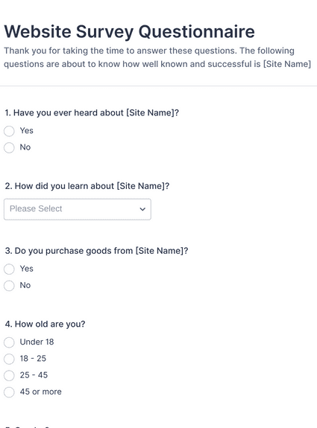
Examples:

Slide 28
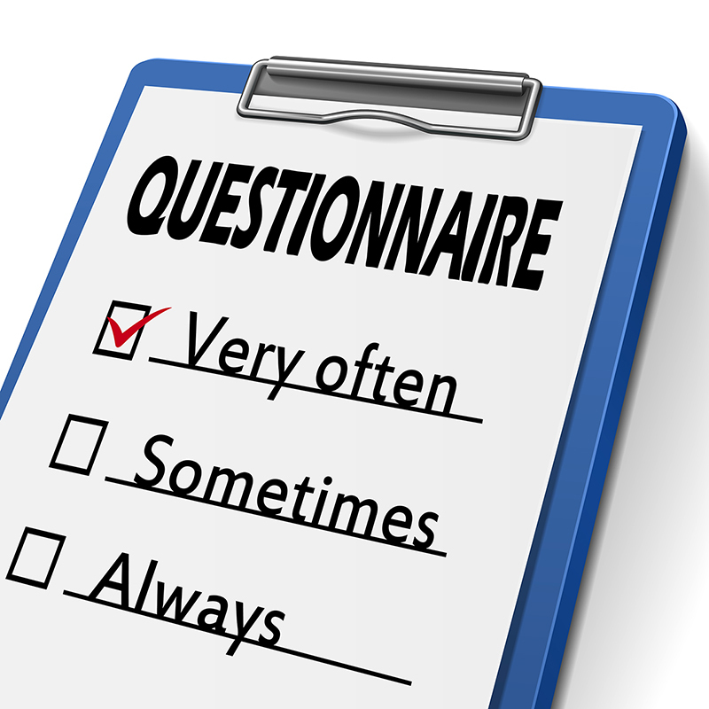

Slide 29
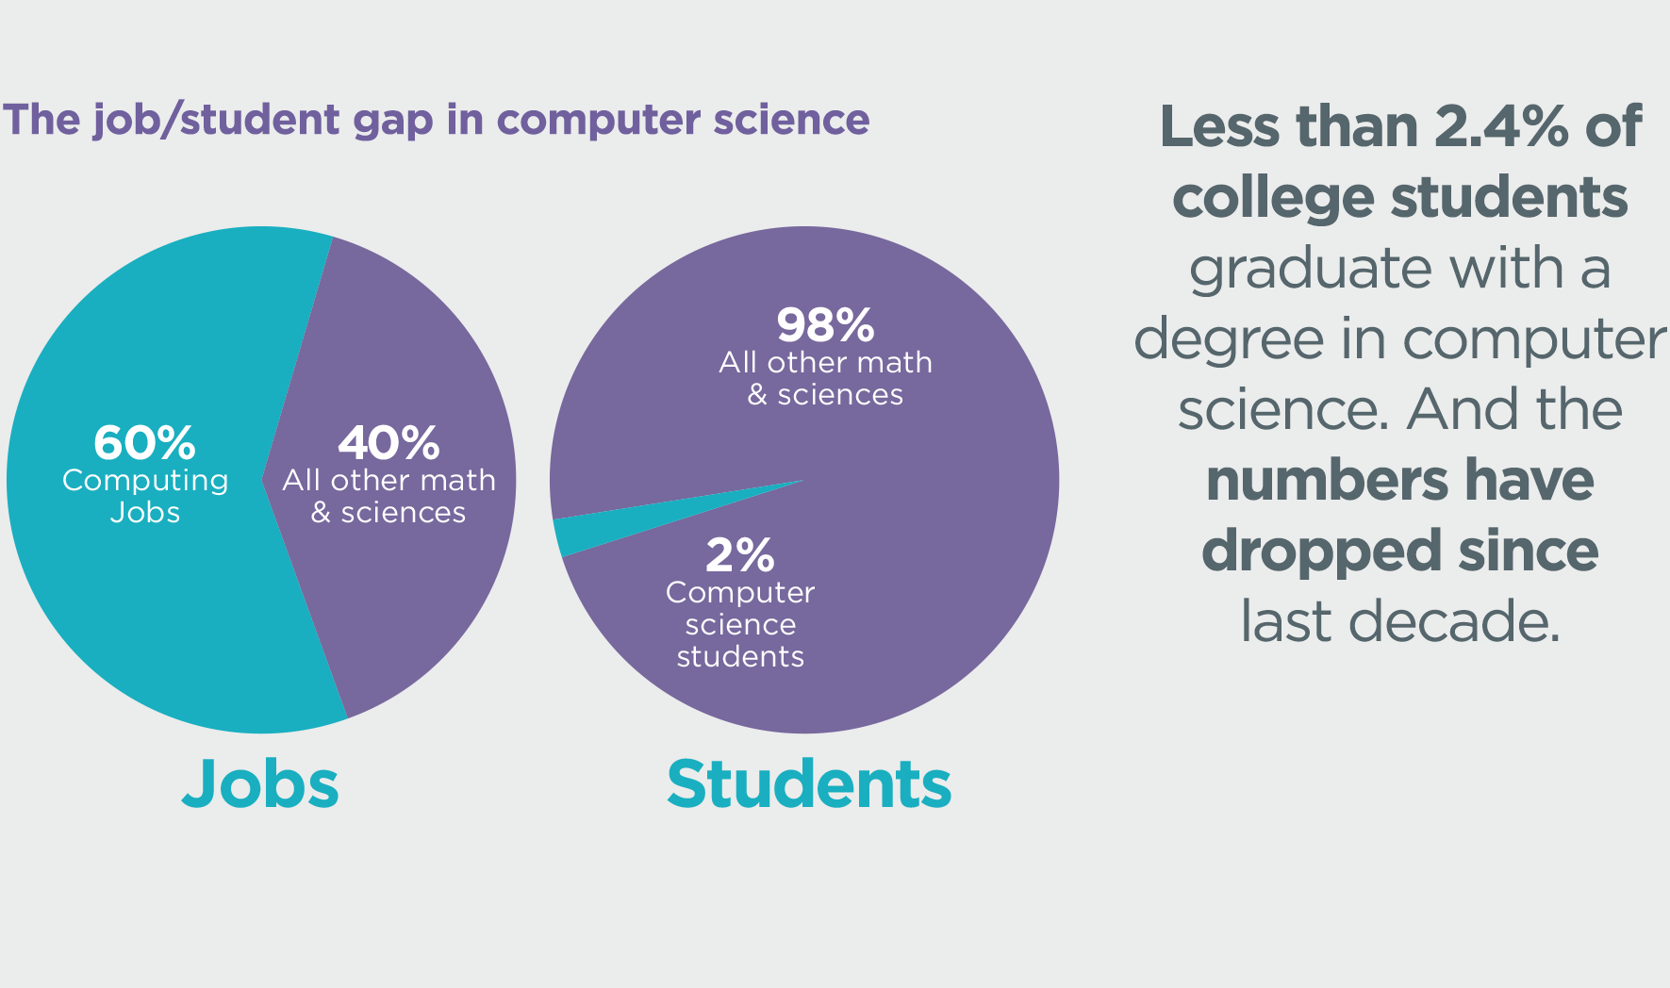

Slide 30
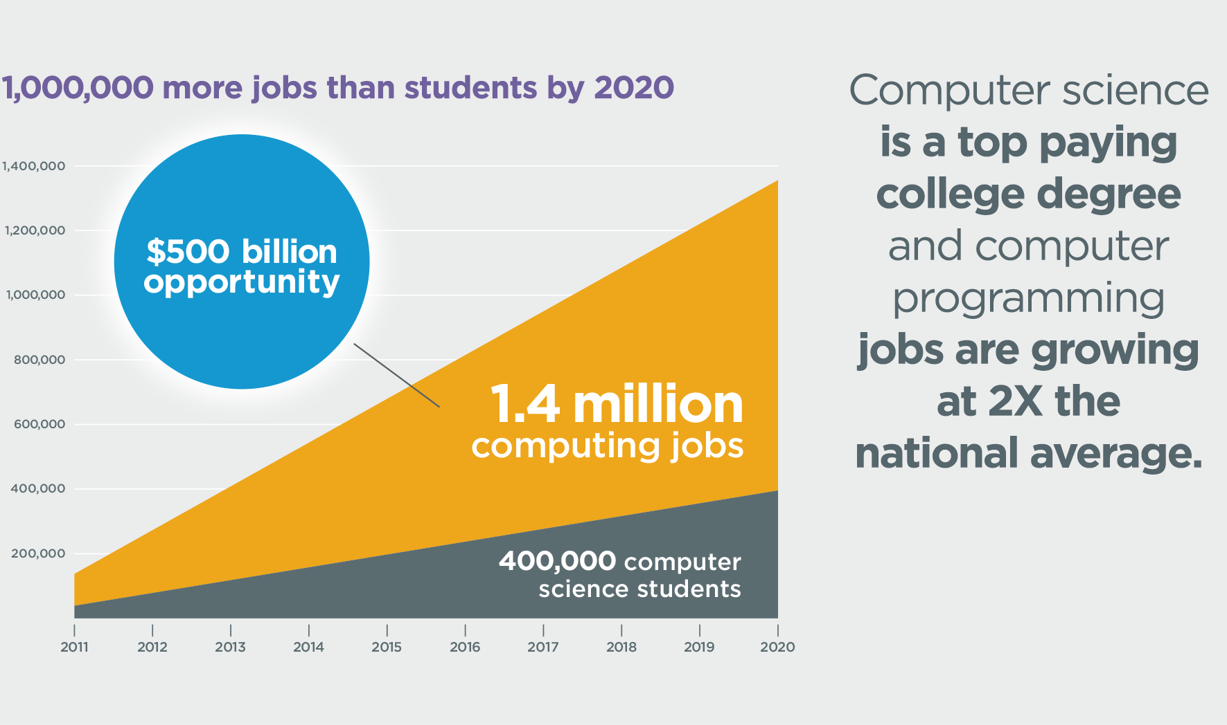

Slide 31
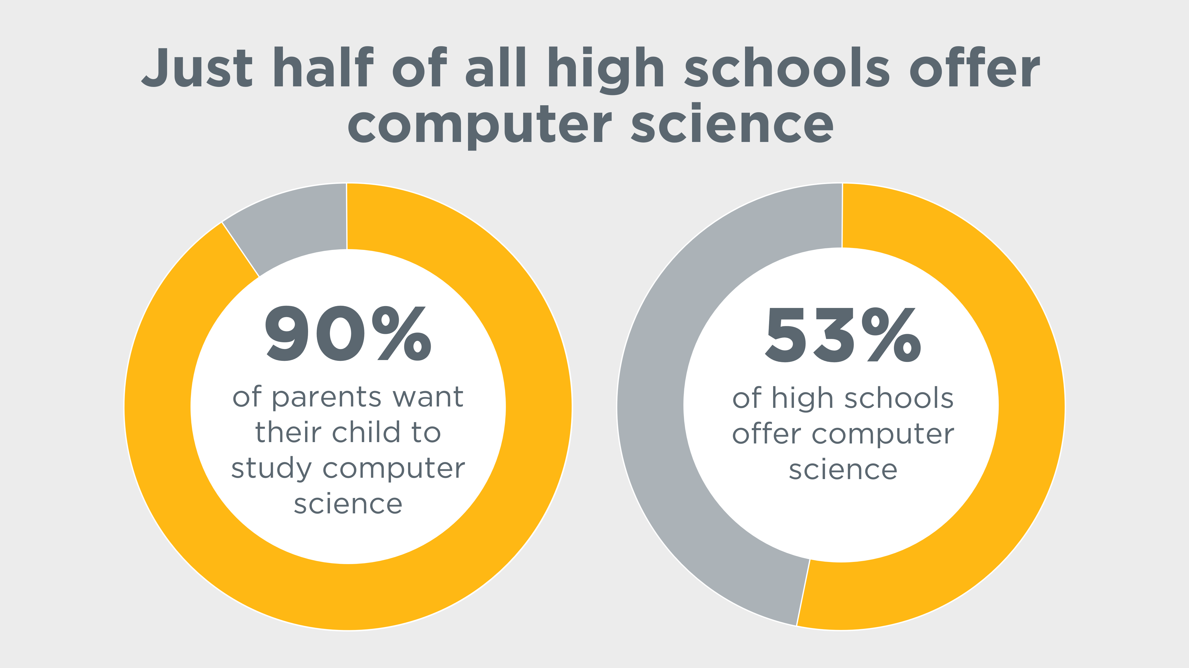

Slide 32
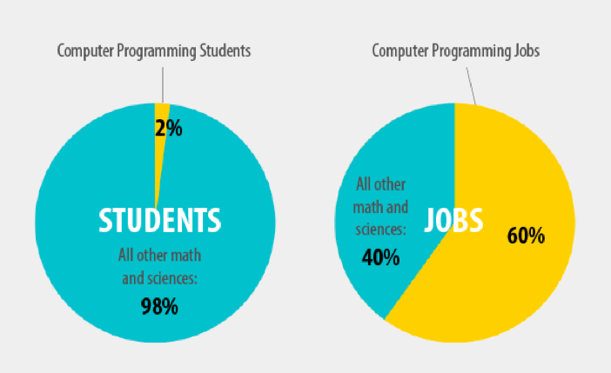

Slide 33
Population, sample and sampling techniques:
It is the scientific process of selecting a few(s) from most(s).
In order to:
-Make research findings accurate
-Obtain information concerning the population
Note:
***It is extremly important that the individuals included in a sample to be representative of the whole population to generalize***

Slide 34
Sampling techniques:
Probability sampling:
Simple random: choose individuals randomly from the population.
Systematic random (Xth) : choose indvs randomly but systimaticly
Stratified random: devide population into sub-popu(strata), eg: age, grade, gender, race…etc, then include SOME individuals from these groups.
Cluster random: devide population into sub-popu(cluster), eg: age, grade, gender, race…etc, then include ALL individuals from these groups.

Slide 35
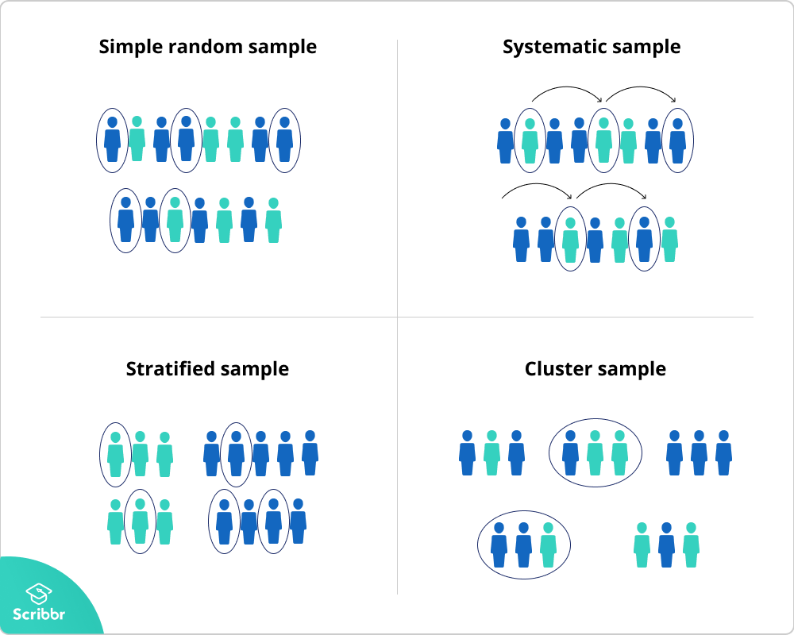

Slide 36
2. Non- Probability sampling:
Convenience: choose individuals that are the closest and most convenient, and the more available.
Purposive - Judgmental: choose individuals that are the most qualified for the researcher.
Voluntary : where individuals volanteer .
Snowball: a researcher who knows an individual who knows individuals who know individuals….

Slide 37
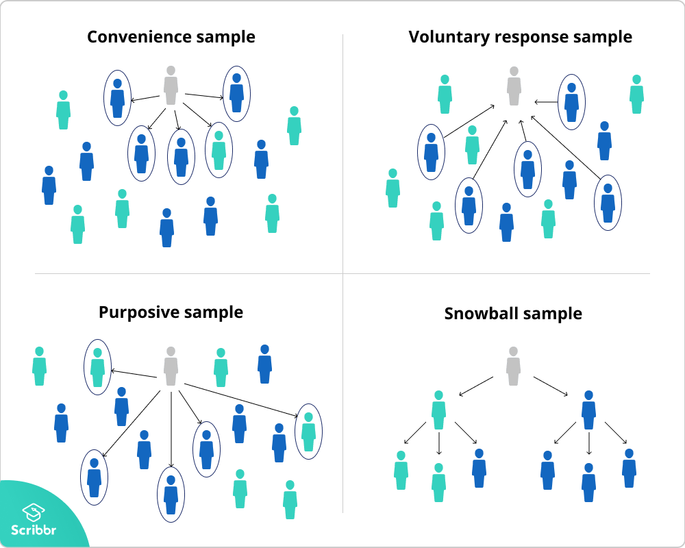

Slide 38
Sampling process steps:
Define the target population.
2. frame the population.
3. choose the sampling technique.
4. determine the sample size.
5. collect data.
objectives:

Slide 39
Simple past tense
1. most used verbs:
to be to do to have
was/were did had
on:
2. Note :
-to be/to do,and to have are also known as auxiliaries
When the verb (to do) is in the past, the next verb is in the infinitive form (stem).
eg: In our research we found that…
In our research we did find that…
on:

Slide 40
Extra examples:
1. Affirmative form:
1.The conducted survey showed that python was easier than JS to beginners.
2. 20% of people we asked said that they struggle to find an appropriate programming language.
3. It was found that most college students struggle from depression during their exams period.
4- CS was first established in the USA.
on:

Slide 41
Extra examples:
2. Question form:
When Was CS founded?
2. Why did you choose CS as your major?
3. Was your study accurate enough?
4. Did you find the bugs on the program?

Slide 42
Extra examples:
3. Negative (negation)form:
The rule: aux+not.
1.The findings were not (weren’t) accuarte.
2. IT was found in the late 60’s.
3.I did not choose computer science as a major because my parents said so.
4.NO, it was not accurate enough.
5.NO, I did not find bugs in the program.

Slide 43
Unit5: results and discussion

Slide 44
1- results:
In a scientific research, usually we interpreate the results in a form of:
a/Non-textual (visual) elements:figures (tables, grams, charts, graphs etc.). Using the present simple to inform the reader about all details.
b/Textual elements: topics, themes, opinions, interviews, etc. Using the past tense to present them to the reader.

Slide 45
2- discussion:
It is about interpreating, comparing and contrasting results and showing their relation with the existing knowladge(theoratical part).
It is where the researcher would tell whether the hypothesis has been confirmed or not. It’s where the researcher answers the research question(s). It also where unexpected elements of the research are shown, reported and explained. Everything discussed using the present tense.

Slide 46
The present simple tense:
a-how:
Subject+stem
Subject+stem+s/es(he, she, and it)
b-why:
We use the present simple to express:
1- general truth(facts).
2- routines and daily activities
3- reality and give defenitions

Slide 47
The present simple tense:
Examples:
1-JAVA can draw anything that is possible with the SVG element.
2-this graph support is new.
3-JSAV supports types of visulizations on multiple engagement levels.
4-HTML5 has quickly become an Internet standard.

Slide 48
Thank you!

